Slide 1

Annai college of engineering and technology Department of computer science and engineering RETAIL SALES FORECASTING TO ENHANCE BUSINESS
PRESENTED BY : MOHAMED NIKKAS J UNDER THE GUIDANCE OF
MOHAMED RASITH M Ms.S.JAYASRI.M.E.,
COURSE: BE. Computer Science and Engineering
COLLEGE NAME: Annai College of Engineering and technology
BATCH: 2022-2026

Slide 2
ABSTRACT
Retail businesses need accurate sales forecasting to manage inventory and improve profits.
This project uses Machine Learning algorithms to predict future retail sales effectively.
The system analyzes historical sales data as product category, sales trends, city, and seasonal demand.
Random forest regressor algorithm is used to identify patterns and forecast future sales values.
The prediction results help businesses reduce losses, improve planning, and make better strategic decisions

Slide 3
PROJECT INTODUCTION
This project focuses on predicting Units Sold in a retail environment using machine learning tachnique.
It uses features like time (Year, Quarter), product category, location (State, City), and transaction type to understand customer demand patterns.
The goal is to build a model that can forecast future demand, helping businesses improve inventory management and make better data-driven decisions.
planning marketing strategies during peak demand periods like festivals or seasonal changes.

Slide 4
EXISTING SYSTEM
Traditional sales prediction is done manually or using simple statistical methods.
These methods often produce less accurate results.
The system requires more human effort and time and Difficult to handle large datasets.
Cannot easily capture complex relationships between features.
Limited capability for real-time prediction and analysis.
ADVANTAGE :
Simple and easy to understand
Requires minimal technical knowledge
Low implementation cost
Works well for small datasets
DISADVANTAGE :
Cannot capture complex relationships between features
Time-consuming and requires manual effort
Difficult to handle large datasets.
Lower prediction accuracy.

Slide 5
PROPOSED SYSTEM
The proposed system uses Machine Learning techniques for retail sales forecasting.
The system analyzes historical sales data such as category, city, season, and sales trends.
Random Forest algorithm is used to predict future sales accurately.
It reduces manual effort and improves forecasting efficiency.
Visualizes results using Streamlit dashboard.
ADVANTAGE :
Higher prediction accuracy compared to traditional methods.
Reduces manual work and saves time.
Supports data-driven business decision-making.
Handles large amounts of retail data efficiently
DISADVANTAGE :
Needs computational resources
Requires good quality data
Internet or software-related issues may affect system performance.
Prediction accuracy may decrease with incorrect or incomplete data.

Slide 6
SYSTEM REQUIREMENTS
Hardware requirements:
Processor: Intel i3 or above
RAM: 4GB or above
Storage: 10GB free space
Network: stable network connection
Software Requirements:
Python
Jupyter Notebook
Visual studio code
Google Colab
Libraries:
Pandas
NumPy
Scikit-learn
Matplotlib
Seaborn
Streamlit

Slide 7
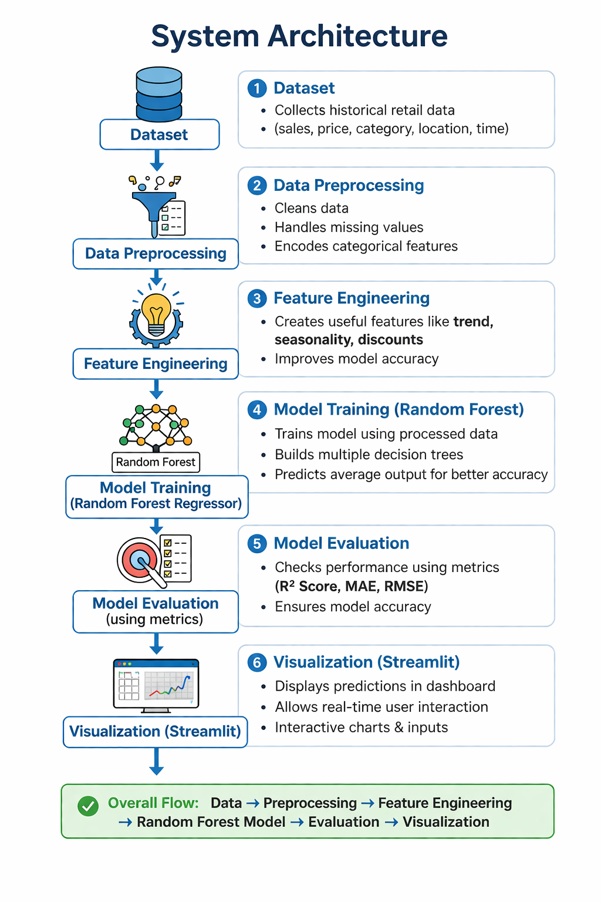

Slide 8
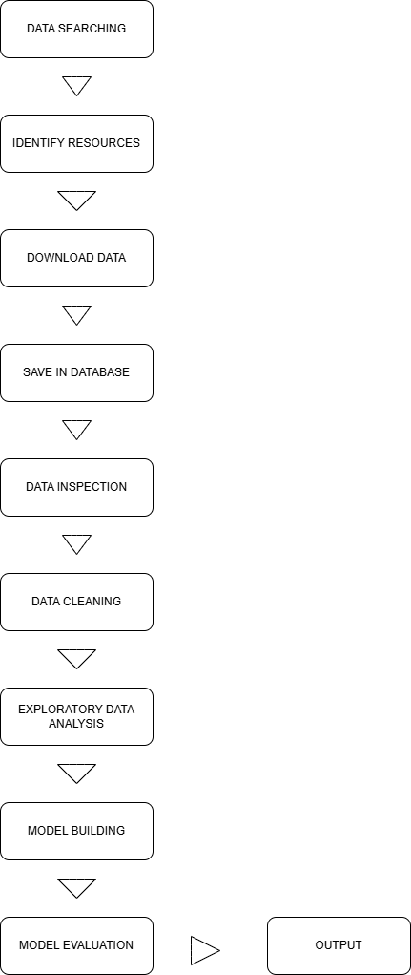

Slide 9
LITERATURE SURVEY
Patel and Kumar (2025) Used advanced algorithms for sales forecasting on large retail datasets. Their study showed good performance but lacked proper feature engineering and real-time implementation.
Singh and Rao (2025) Developed a retail forecasting model using time-based features like month and quarter. The study improved trend analysis but did not include location-based factors.
Machine Learning (The Baseline): Studies from 2024–2025 frequently cite XGBoost and Random Forest as the industry gold standard for structured data. Recent papers (e.g., Venkiteela, 2025) show XGBoost achieving R2 scores of 0.87 in multi-city retail environments due to its ability to handle feature interactions.
Previous studies show that Random Forest and other ensemble models provide better accuracy for sales prediction. However, limitations exist in feature engineering and visualization. This project overcomes these issues by using optimized features and a Streamlit dashboard for real-time predictions.

Slide 10
MODULES EXPLANATION
1. Data Collection
Import the retail sales dataset from CSV files or databases.
Collect historical sales data such as year, city, category, season, and sales amount.
Ensure the dataset contains sufficient records for accurate forecasting.
2. Data Preprocessing
Handle missing values in the dataset.
Remove duplicate records to improve data quality.
Convert data types into proper formats for analysis.
Clean unwanted or inconsistent data values.
3. Feature Engineering
Encode categorical features such as State, City, and Category.
Select important features that influence sales prediction.
Transform data into a suitable format for Machine Learning models.
4. Model Training
Split the dataset into training and testing datasets (X_train, X_test, y_train, y_test).
Train Machine Learning models such as Linear Regression.
Allow the model to learn patterns from historical sales data.

Slide 11
5. Model Evaluation
Evaluate model performance using metrics such as R² Score and RMSE.
Compare actual sales values with predicted sales values.
Measure the accuracy and efficiency of the forecasting model.
6. Prediction Module
Predict future retail sales for upcoming years.
Generate sales forecasting results based on input data.
Help businesses plan inventory and sales strategies effectively.
7. Visualization Module
Display sales trends and prediction results using graphs and charts.
Create dashboards for better understanding of sales analysis.
Provide visual insights for business decision-making.

Slide 12
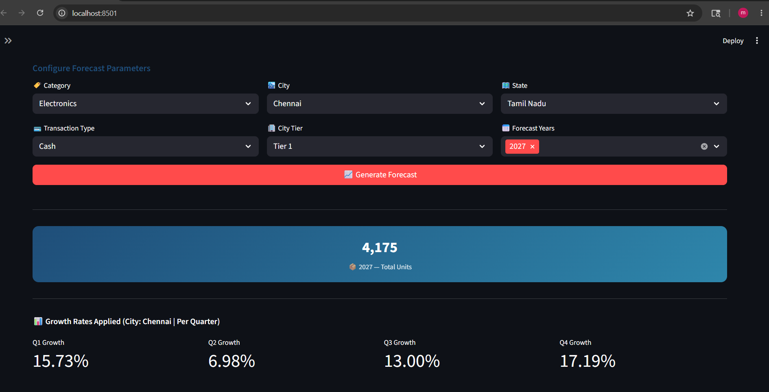
Output with visuals

Slide 13
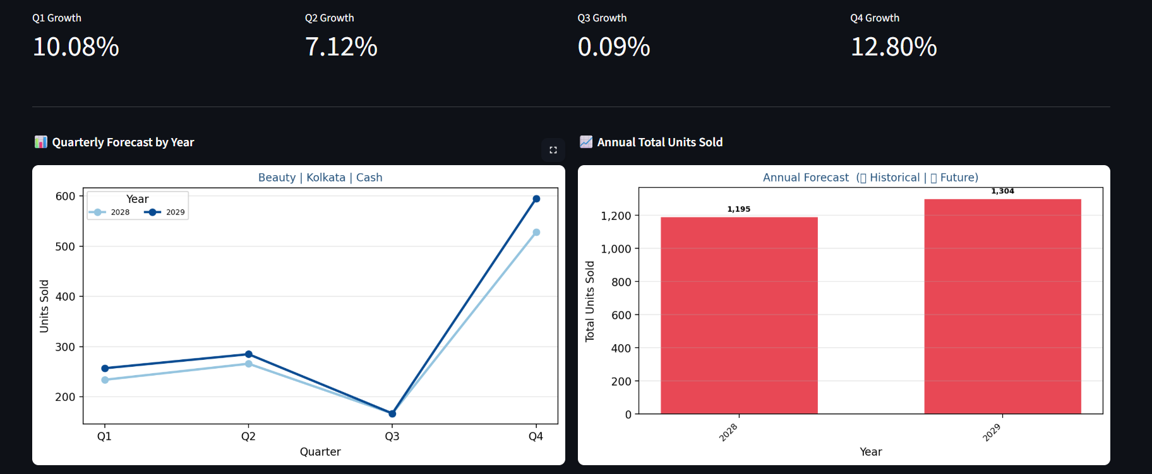
Output with visuals

Slide 14
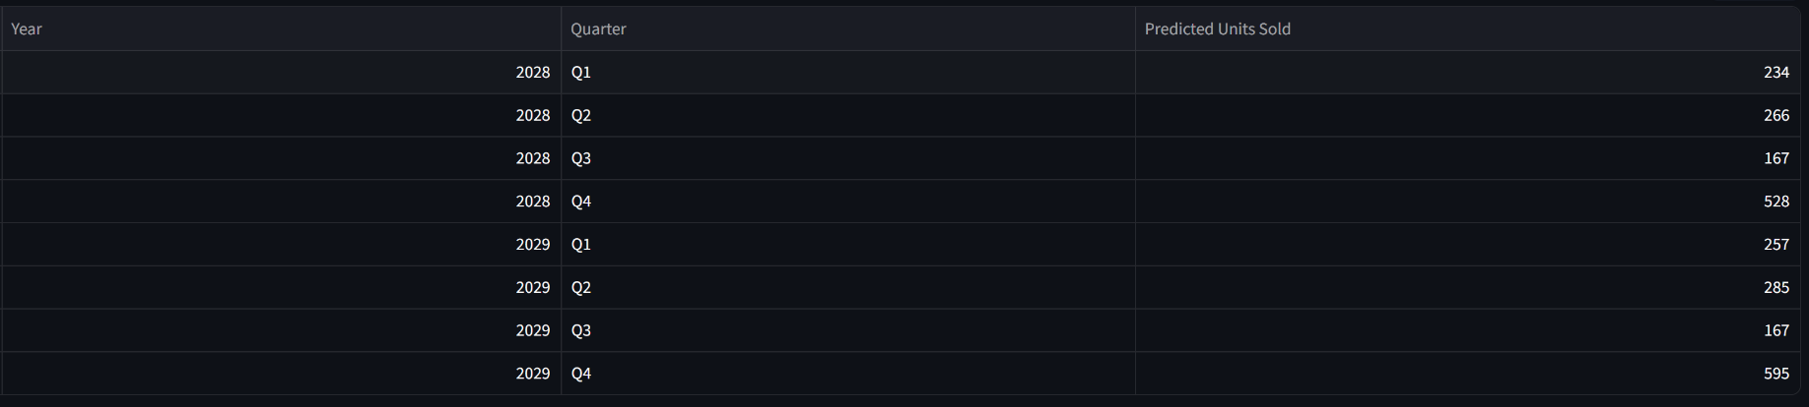

Slide 15
REFERENCES
Aurélien Géron, Hands-On Machine Learning with Scikit-Learn, Keras, and TensorFlow, O’Reilly Media, 2019.
Jiawei Han, Micheline Kamber, and Jian Pei, Data Mining: Concepts and Techniques, Morgan Kaufmann Publishers, 2011.
Trevor Hastie, Robert Tibshirani, and Jerome Friedman, The Elements of Statistical Learning, Springer, 2009.
Douglas C. Montgomery, Cheryl L. Jennings, and Murat Kulahci, Introduction to Time Series Analysis and Forecasting, Wiley Publications, 2015.
Ian Goodfellow, Yoshua Bengio, and Aaron Courville, Deep Learning, MIT Press, 2016.

Slide 16
CONCLUSION
This project successfully developed a machine learning model to predict Units Sold in a retail environment.
The implementation of advanced algorithms like Random Forest Regressor improved prediction accuracy compared to traditional methods.
Additionally, the integration of a Streamlit dashboard enables easy visualization and real-time predictions.
Overall, the system helps businesses make better decisions in inventory management, demand planning, and sales strategy, demonstrating the practical value of machine learning in retail analytics.

Slide 17
THANK YOU

